Slide 1

Discover e.V. 2014 to 2026

Slide 2
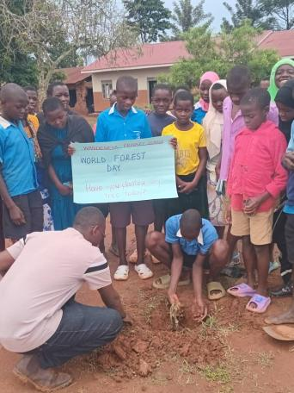
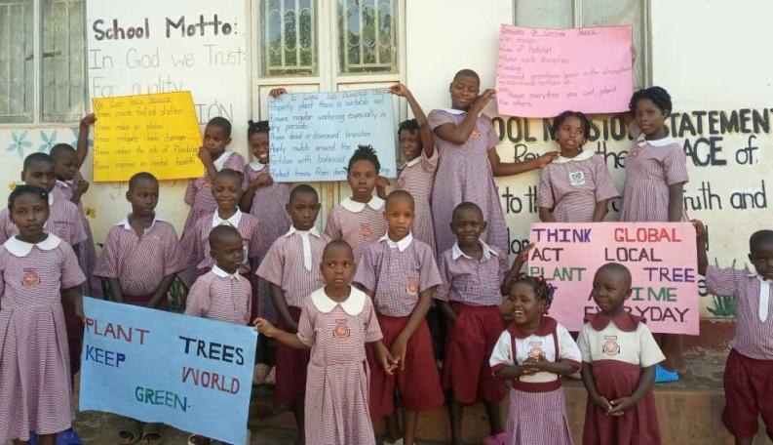
International Day of the Forest: 21 March 2025
Mayuge, Uganda
Kirimya, Uganda

Slide 3
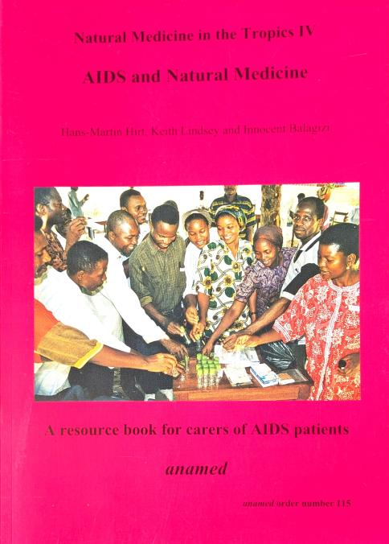
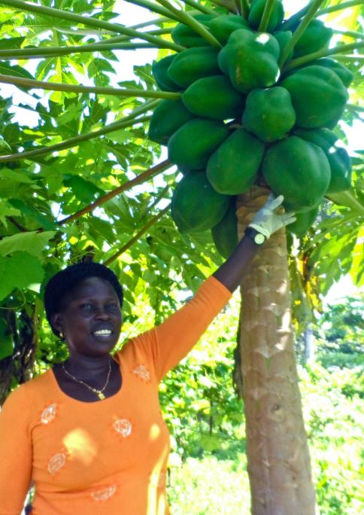

Slide 4
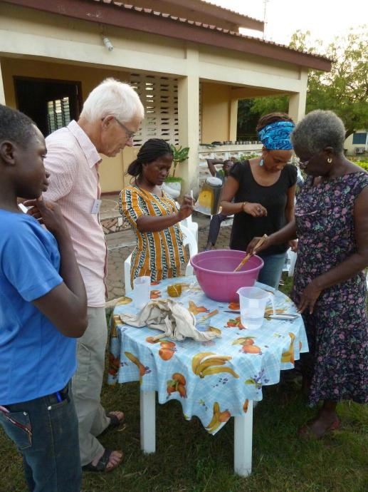
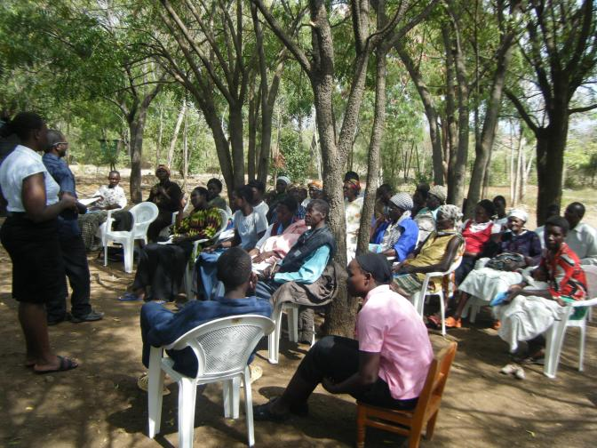
Conducting Seminars

Slide 5


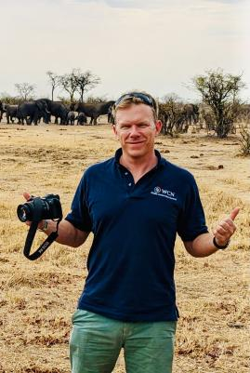
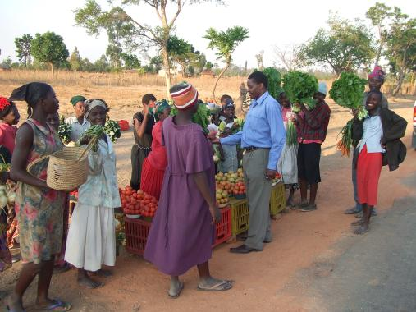
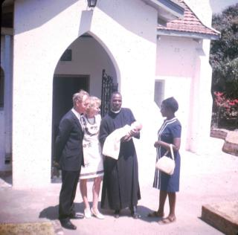
Before 1980 Rhodesia
From 1980, Zimbabwe
2024
1975

Slide 6
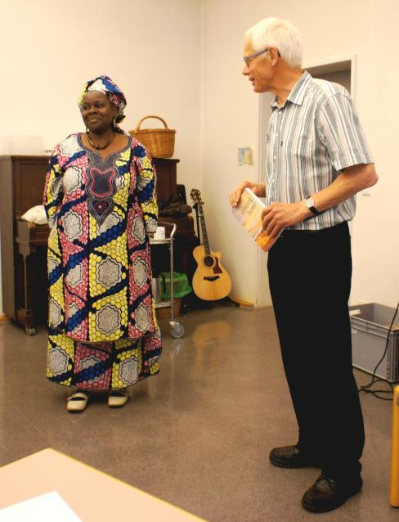
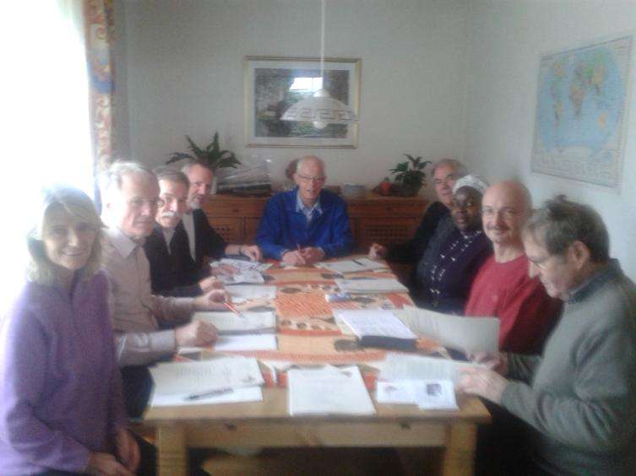
Founding „Discover e.V.“ on 5 April 2014

Slide 7
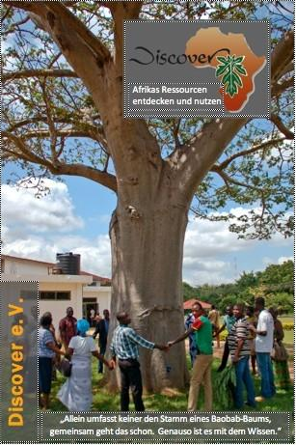
No one person can put their arms round a baobab tree, but by working together one can. It is the same with knowledge!

Slide 8
The aims of Discover Irrespective of religion, gender or tribe, we wish to contribute to:
the development of self-confidence, new skills and income
building trust and confidence
peace and reconciliation in the community
promoting good health through organic gardening, good nutrition, hygiene and natural methods of healing

Slide 9
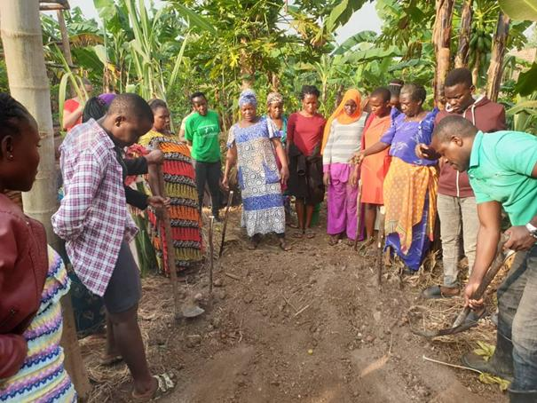
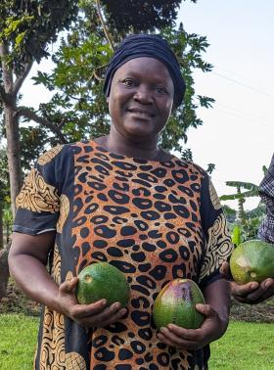
Seminar in Kyempapu, Uganda, on growing vegetables organically – an initiative of Rehema Naymalo

Slide 10
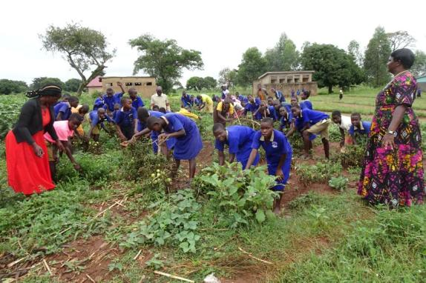
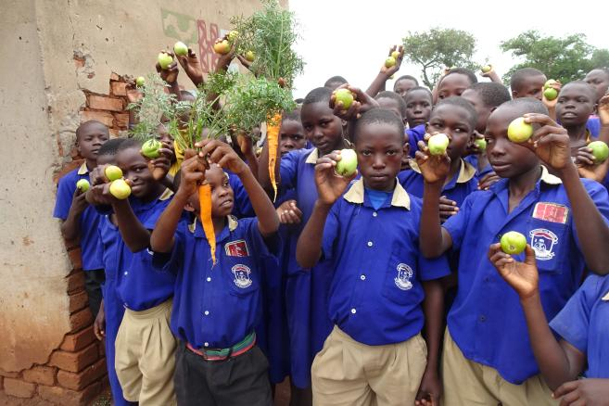
Kasokwe Primary School, Uganda Vegetable and fruit garden in the school grounds – an initiative of Eric Kihuluka

Slide 11
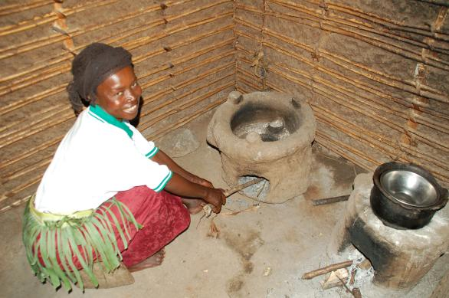
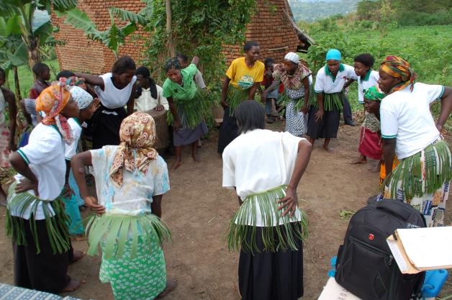
Production of fuel efficient stoves -
an initiative of Kenja Thomas
The women in the village show their appreciation with a traditional dance.

Slide 12
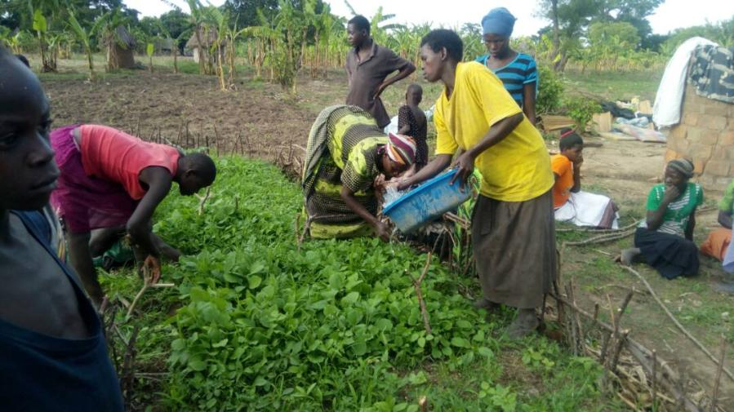
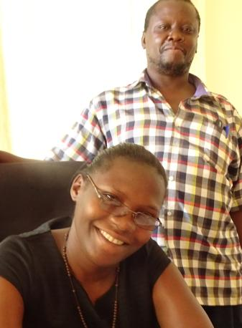
2018: Eric Kihuluka in Izinga, Bezirk Kaliro, Uganda,
Today members of the community work much better together!

Slide 13
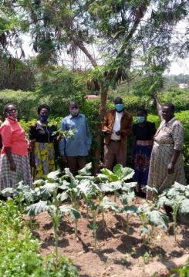
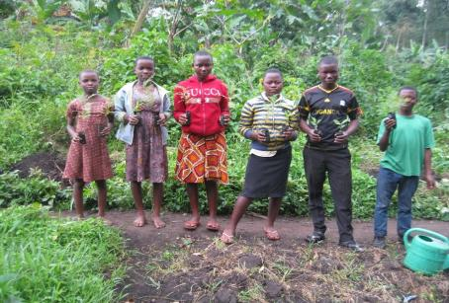

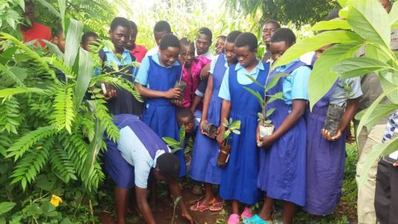
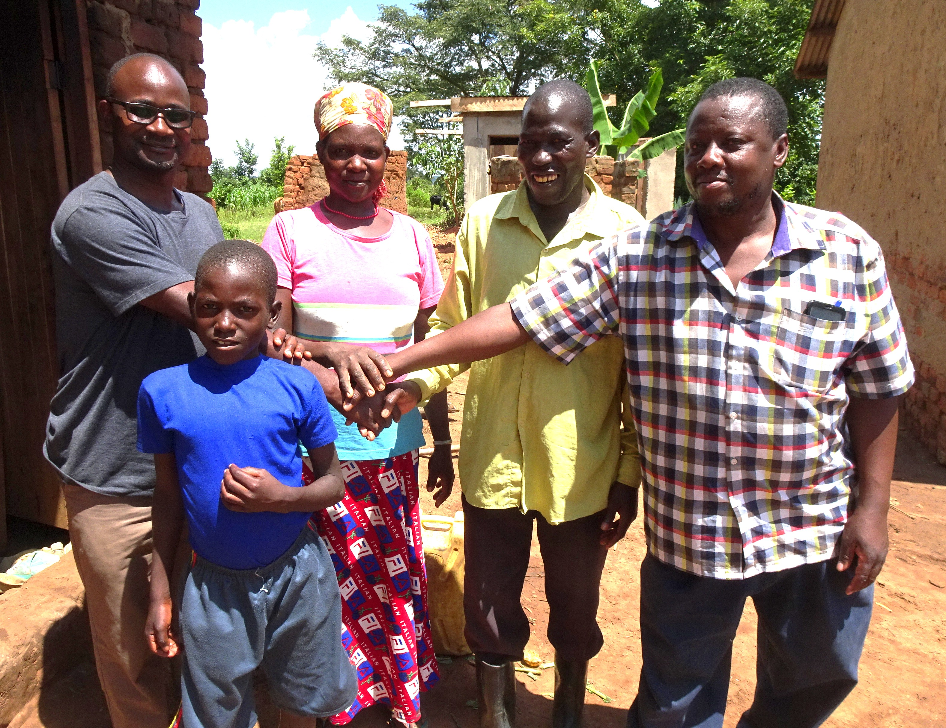
2020
It has all been worth it!

Slide 14
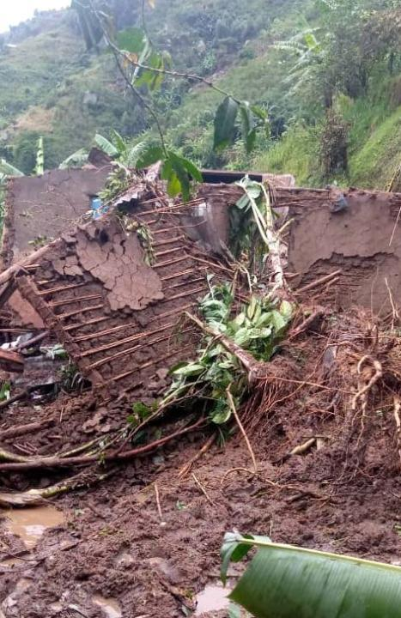
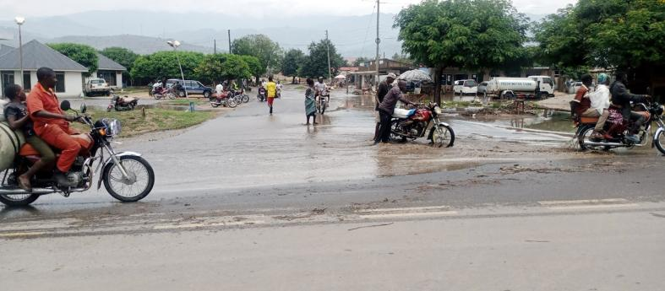
Impacts of the climate crisis: Floods and landslides, homelessness and fatalities

Slide 15
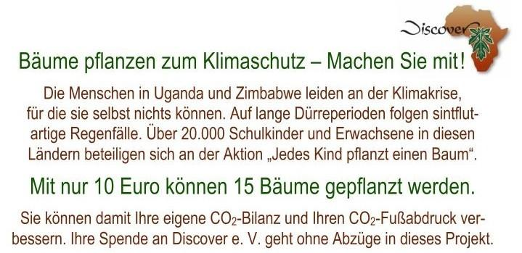
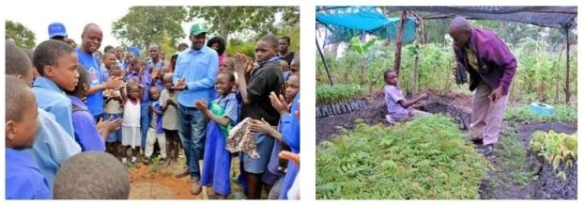
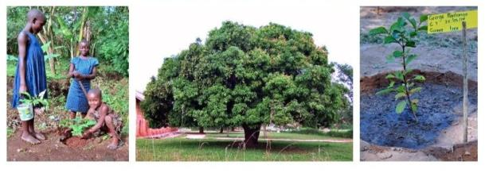
Publicity card – 2020 (only in German The key sentence – with only 10 Euro 15 trees can be planted)

Slide 16
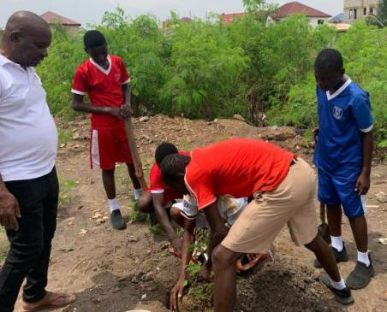
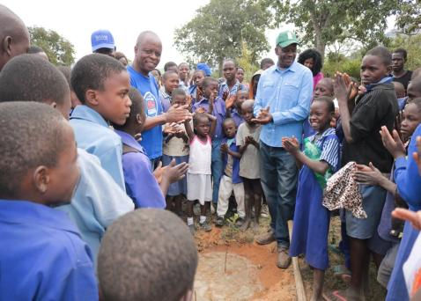
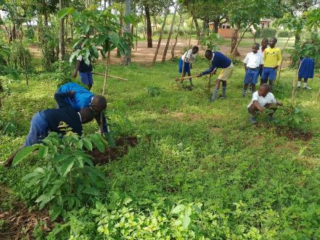
Tree planting in Uganda, Simbabwe, Kenya und Ghana

Slide 17
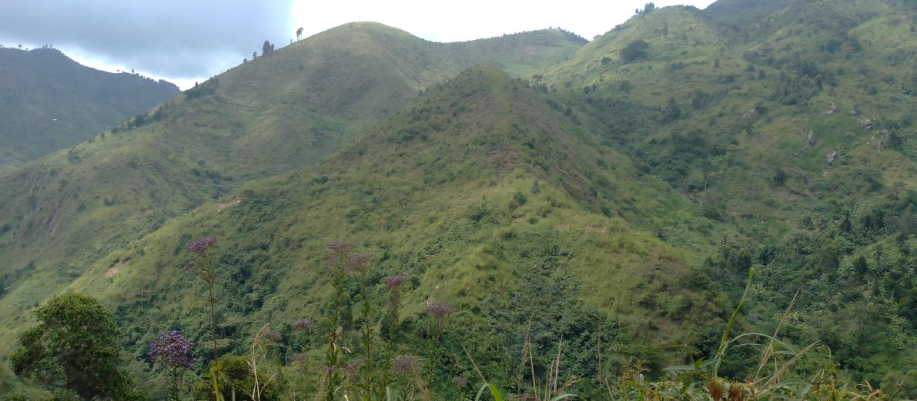
Deforested slopes of the Rwenzori Mountains, West Uganda

Slide 18
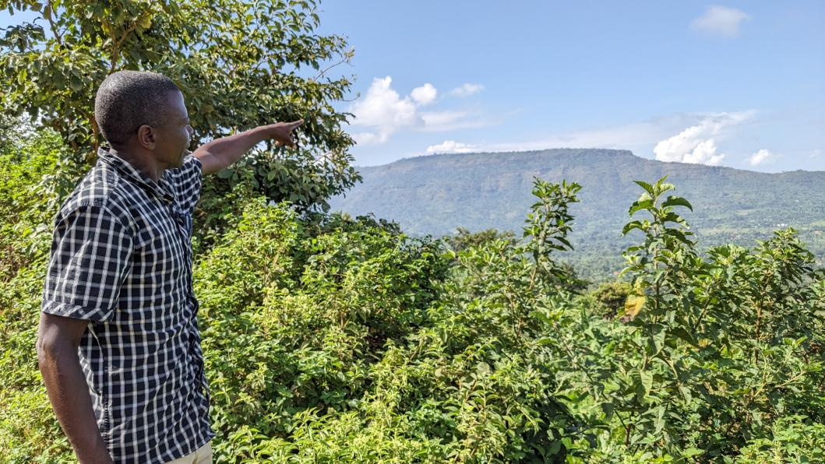
Makabuli Yusuf on the Elgon Mountains in East Uganda

Slide 19
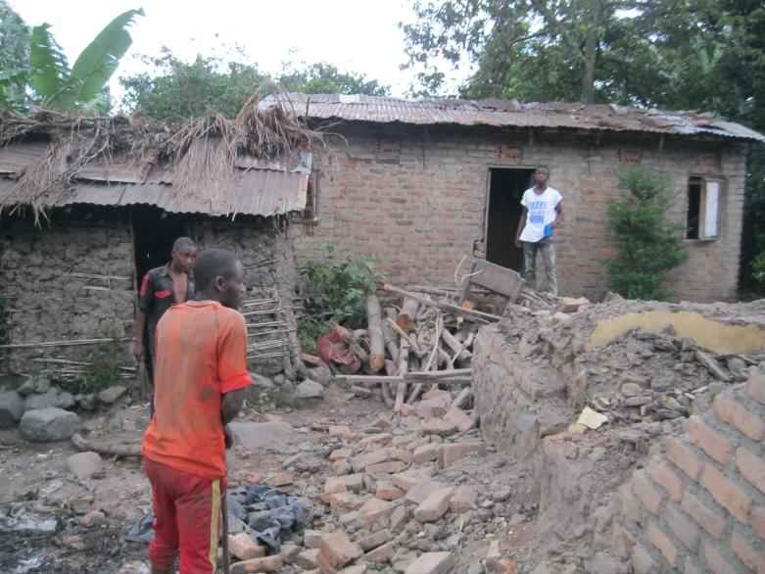
2020: Destruction caused by floods on the slopes of the Rwenzori Mountains

Slide 20
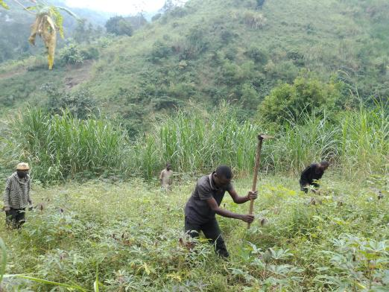
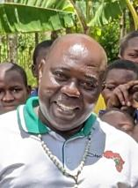
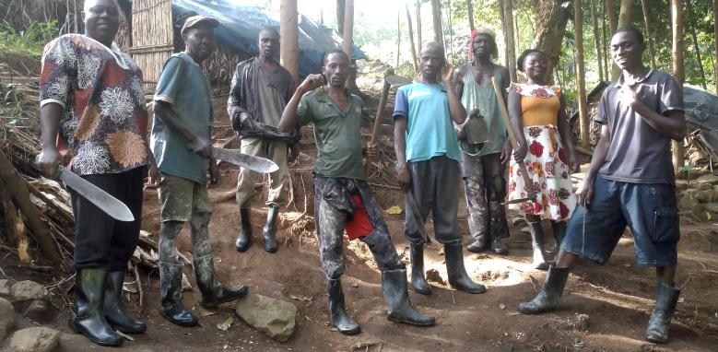
2025: Reforestation on the Rwenzori Mountains

Slide 21
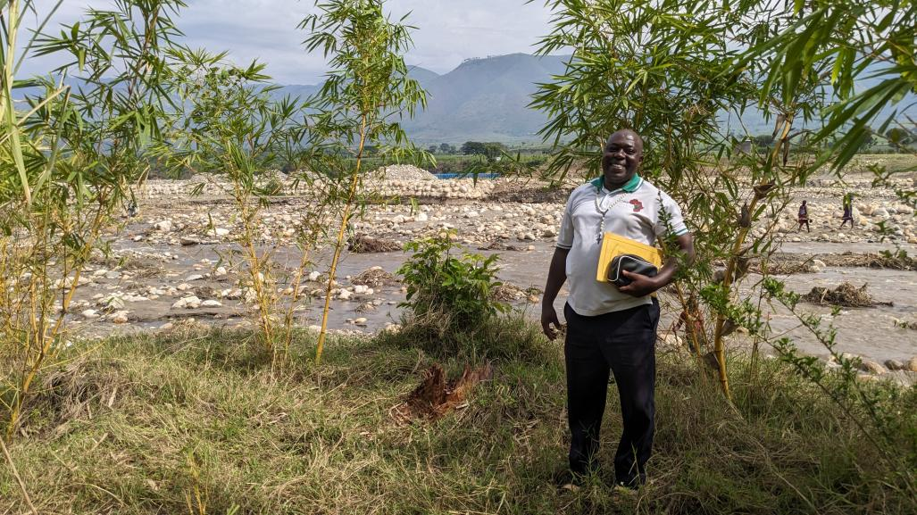
Bamboo planted on the bank of the Nyamwanba River

Slide 22
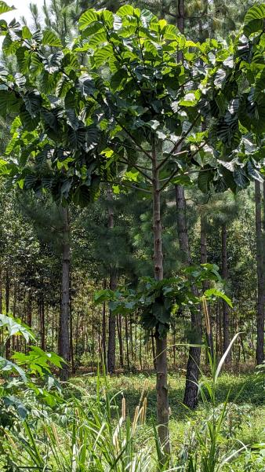
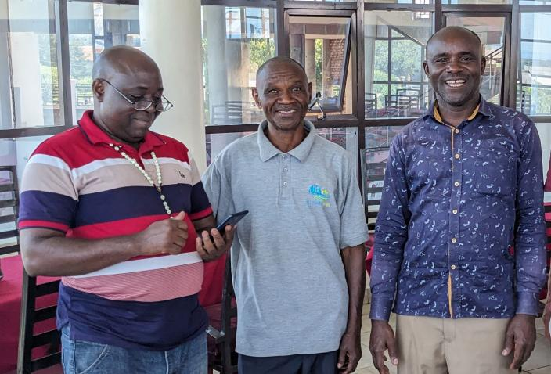
Thomas, Emmanuel, Robert: 55 000 trees The results are spectacular!

Slide 23
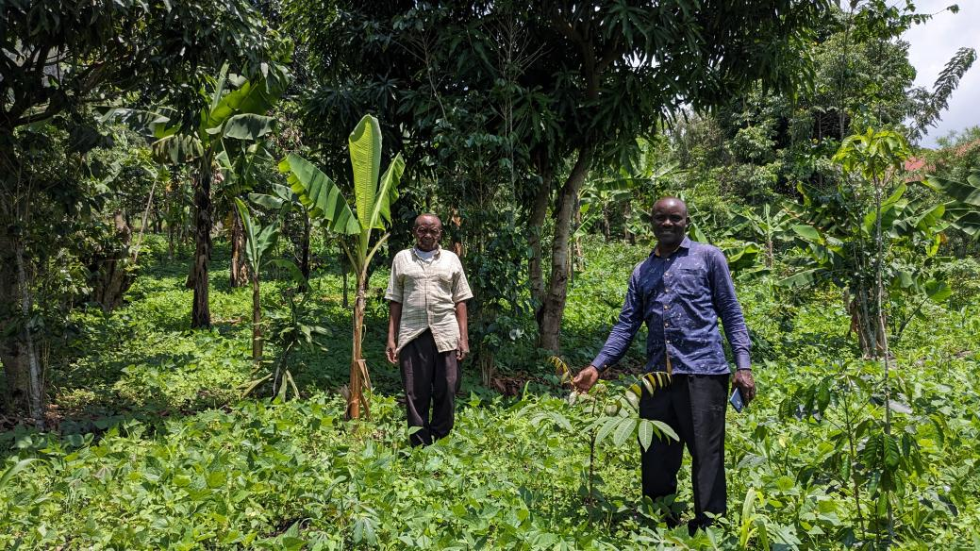
Agroforestry improves nutrition and generates income.

Slide 24
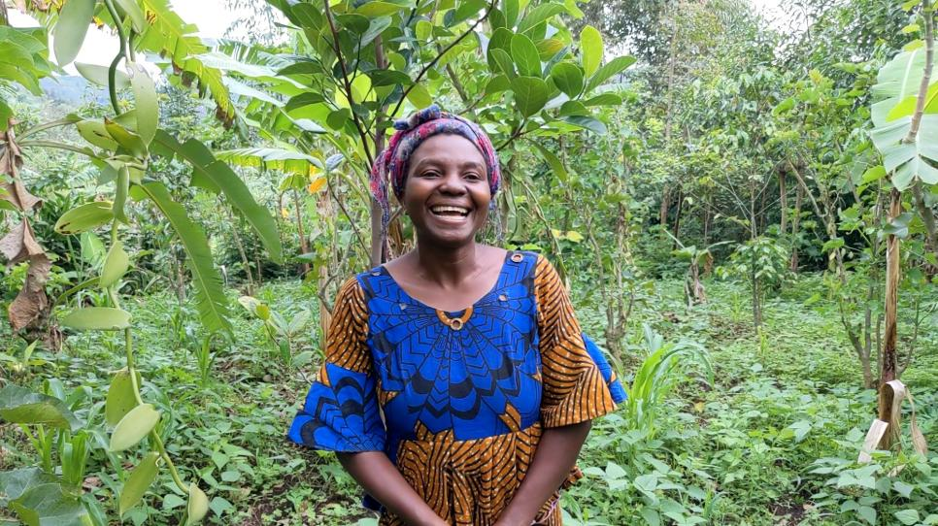
Kabugho Deborah, headteacher in a primary school, in her own agroforestry garden

Slide 25
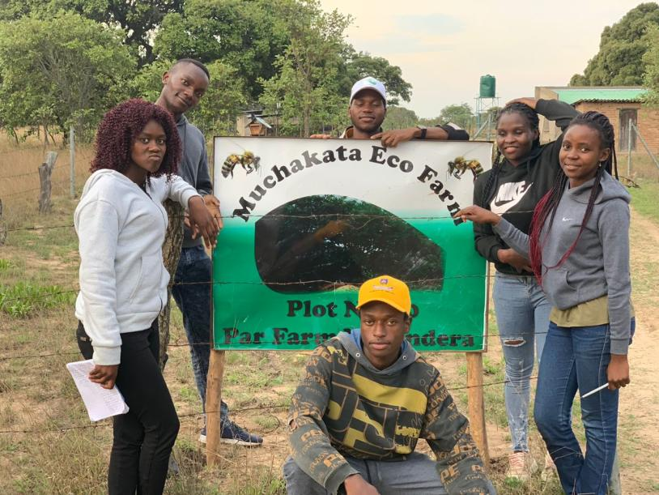
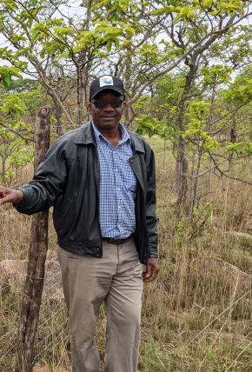
EcoFarm in Zimbabwe with Joachem Nyamande

Slide 26
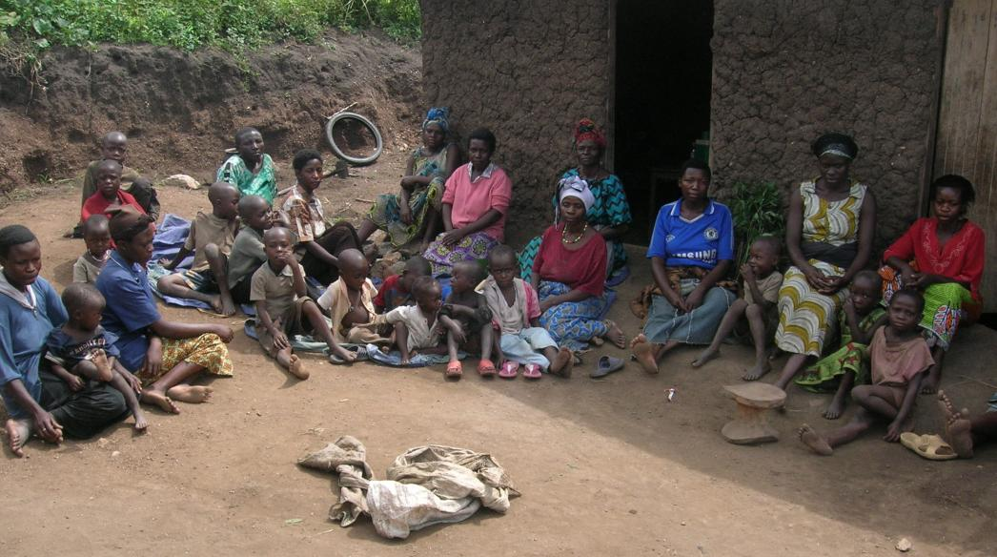
2011: Women and orphan‘s group in Kighengi, West Uganda

Slide 27
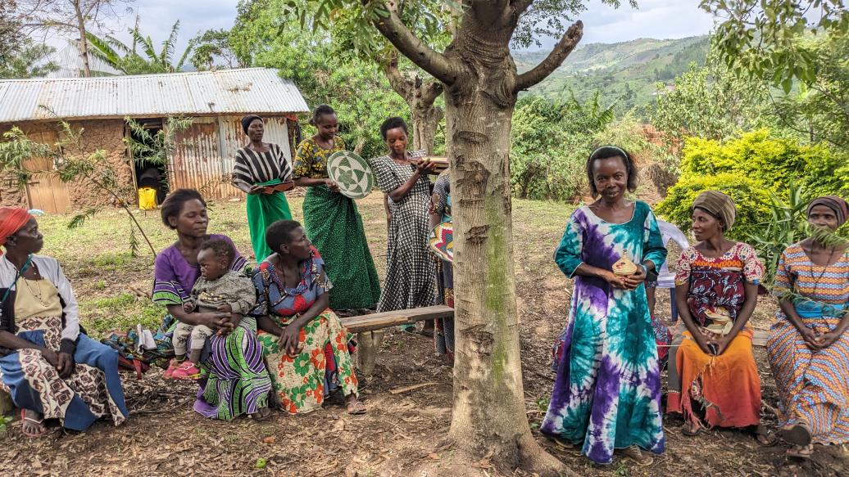
2023: The same group: The women make baskets for sale!

Slide 28
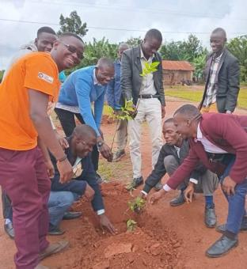
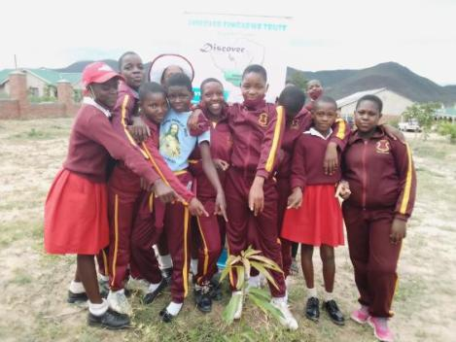
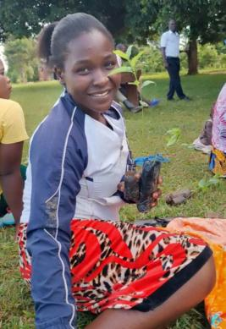

Work with
schools

Slide 29


Tree nurseries: Young trees are given out and provide income.

Slide 30

Our evaluation – inspired by the experience of Eric Kihuluka and his „Mikwano“-Team in Uganda
Discover’s work is long-term.
Discover partners are themselves members of the community in which they work.
They know from their own experience what the people there really need.
The little money they have or receive is used directly in their work.

Slide 31







